Slide 1

CSE4037
REINFORCEMENT LEARNING
MONTE CARLO
COMPONENTS

Slide 2
Module No. 3
Deep Reinforcement Learning – 8 Hours
Dynamic Programming
Monte Carlo
Components
Control in Monte Carlo
LPI Convergence
Value Iteration
Policy Iteration
Q-Learning
Q-learning with deep networks, Double Q learning, replay memory, Deep NN Architectures for RL

Slide 3
Monte Carlo
The Monte Carlo method for reinforcement learning learns directly from episodes of experience without any prior knowledge of MDP transitions. Here, the random component is the return or reward.
It can only be applied to episodic MDPs

Slide 4
Monte Carlo
The reason is that the episode has to terminate before we can calculate any returns. Here, we don’t do an update after every action, but rather after every episode. It uses the simplest idea – the value is the mean return of all sample trajectories for each state.
Monte Carlo methods require only experience — sample sequences of states, actions, and rewards from actual or simulated interaction with an environment. Learning from actual experience is striking because it requires no prior knowledge of the environment's dynamics, yet one can still attain optimal behavior.

Slide 5
Monte Carlo
Monte Carlo Prediction/ Evaluation
Monte Carlo Control

Slide 6
Monte Carlo Prediction
Prediction refers to the problem of estimating the values of states, a value of a state is an indication of how good is that state for an agent in the given environment, the higher the value of the state the better it is to be in that state.
An obvious way to estimate the value of a state is to simply average all the returns that are observed after a visit to the state, and as we visit the state more often, the average return will converge to the true value of the state in expectation.

Slide 7
Monte Carlo Prediction
There are two ways in which we can average the return after a visit to a state which are discussed as follows.
First Visit Monte Carlo (first-visit MC): In the first visit Monte Carlo methods we average all the rewards observed after the first visit to the state.
Every Visit Monte Carlo (every-visit MC): In every visit Monte Carlo methods we average the returns following all visits to the state.

Slide 8
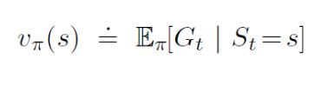
Monte Carlo Policy Evaluation
The goal here, again, is to learn the value function vpi(s) from episodes of experience under a policy pi. Recall that the return is the total discounted reward:
S1, A1, R2, ….Sk ~ pi
Also recall that the value function is the expected return:

Slide 9
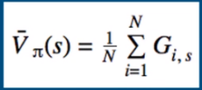
Monte Carlo Policy Evaluation
We know that we can estimate any expected value simply by adding up samples and dividing by the total number of samples:
i – Episode index
s – Index of state
The question is how do we get these sample returns? For that, we need to play a bunch of episodes and generate them.
For every episode we play, we’ll have a sequence of states and rewards. And from these rewards, we can calculate the return by definition, which is just the sum of all future rewards.

Slide 10
Monte Carlo Policy Evaluation
Example
Consider an MDP with a single nonterminal state and a single action that transitions back to the nonterminal state with probability p and transitions to the terminal state with probability 1−p.
Let the reward be +1 on all transitions, and let γ=1. Suppose you observe one episode that lasts 10 steps, with a return of 10.
What are the first-visit and every-visit estimators of the value of the nonterminal state?

Slide 11
Monte Carlo Policy Evaluation
Example
First-visit estimator: V(s) = 10
Every-visit estimator: V(s)= 10+9+8+7+6+5+4+3+2+1/10 =5.5
Both first-visit and every-visit Monte Carlo methods converge to true state values when we visit each state many times.

Slide 12
First Visit Monte Carlo
Average returns only for first time s is visited in an episode.
Here’s a step-by-step view of how the algorithm works:
Initialize the policy, state-value function
Start by generating an episode according to the current policy
  Keep track of the states encountered through that episode
Select a state in 2.1
  Add to a list the return received after first occurrence of this state
  Average over all returns
  Set the value of the state as that computed average
Repeat step 3
Repeat 2-4 until satisfied

Slide 13

Every visit Monte Carlo
Average returns for every time s is visited in an episode.
For this algorithm, we just change step #3.1 to ‘Add to a list the return received after every occurrence of this state’.
Let’s consider a simple example to further understand this concept. Suppose there’s an environment where we have 2 states – A and B. Let’s say we observed 2 sample episodes:

Slide 14
Monte Carlo Example
Let’s consider a simple example to further understand this concept.
Suppose there’s an environment where we have 2 states – A and B. Let’s say we observed 2 sample episodes:

Slide 15
Monte Carlo
Value function calculation: (First Visit MC)
V(A) = +3+2-4+4-3+3-3/2 = 2/2 = 1
V(B) = -4+4-3-2+3-3/2 = -5/2 = -2.5
Value function calculation: The total payoff received from the time the state is visited first in an episode (for all the episodes)/number of episodes
Value function calculation for every visit MC
V(A) = +3+2-4+4-3 + +2-4+4-3 + +4-3 + +3-3 /4 = 0.5
V(B) = -4+4-3 + -3 + -2+3-3 + -3 /4
Value function calculation: The total payoff received from the time the state is visited every time in an episode (for all the episodes)/number of times the state is visited

Slide 16
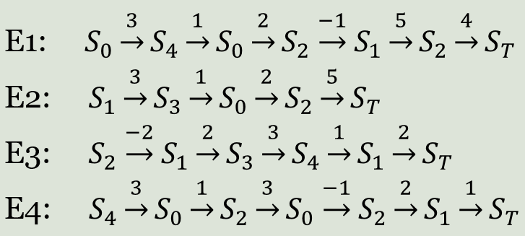
Example
In an RL environment having five states, the four episodes were recorded and are presented below. Estimate the value function of the states using a) every visit monte carlo and b)first visit monte carlo metods. The value on the arrow indicate the reward received and S_{T} represent the terminal state.

Slide 17
Example
The agent starts with the policy that always chooses to go right, and executes the following three trials as mentioned (State, Reward):
Episode 1 - (1,1) → (2,2) → (1,3) → (3,4)
Episode 2 - (1,2) → (1,3) → (2,1) → (2,4) → (3,2)
Episode 3 - (1,1) → (2,1) → (2,4) → (2,3) → (3,2) → (3,6)
Evaluate the Monte Carlo Prediction for all the States 1, 2, 3.

Slide 18
Monte Carlo Policy Evaluation
Now one important fact about Monte Carlo Methods that we should highlight here is that Monte Carlo is one of the few methods in reinforcement learning that do not bootstrap. Bootstrapping means making use of estimates to make a further estimations.
In Monte Carlo methods, an estimate of the value of a state does not depend on the estimate of the other state's value rather estimate of each state is independent of each other, although this is beneficial as it reduces the bias, however, it makes convergence significantly slower, as a result of which Monte Carlo methods are judiciously used in practical applications.

